Slide 1
Production Forecast
Developer: Kimberly Preece

Slide 2
Introduction
This program was designed to learn the beginning concepts of development with C++. The project incorporated the following:
Input/Output
Variables
Loops
Conditional Statements
Arrays
Modules
Save/Retrieve Data

Slide 3
Purpose
The purpose of this program was to give a hands-on experience into Programming. From project analysis, debugging, design, and good programming techniques, this project has allowed me to practice and enhance my programming.

Slide 4
IPO/Design Examples
This program will allow the user to store information vital to the production and manufacturing capabilities of the company.
The user will be able to use the stored information to effectively calculate the monthly needs of production for each station.
This program will allow the user to accurately distribute work loads of each production station and be able to meet the forecasted quota.
After information has been entered the user will be able to manipulate the data to accommodate changes in production.
This program would give daily, weekly, monthly, and quick production projections.
Input | Process | Output
Prompt User for : Part Number Supplier Name Department of Production Station of Production Requesters Information | Store input in system memory. Organize production parts by production station and part number. | User Screen: Shows the output of Organized production by production station, part number.
Prompt User for: Requested Quantity Stock Quantity | Calculate the total of both shipment requirements and stock requirements together for each type of part. | User Screen: Shows the projected amount of production needed off each station for a months’ time.
Prompt User for: Dates of Shipment Dates of Scheduled Production | Option Calculate and divide the number of parts needed for a month’s period and distribute by dates, stations, and part numbers. | User Screen: Each production station shows the date of production needed along with the amount needed each day to meet company needs. Options allow user to adjust production dates as needed.

Slide 5
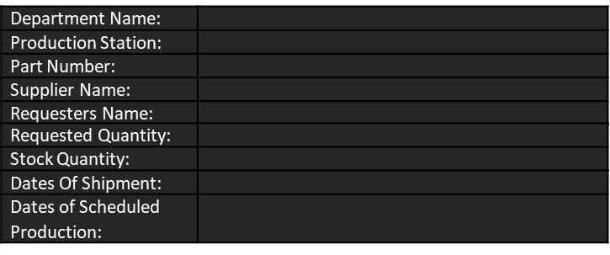
IPO/Design Examples cont.
Sample Ouput
Sample Display
07/12/2021 | 07/13/2021 | 07/14/2021 | 07/15/2021 | 07/16/2021
Station- U9 Part Number- 19522-6B2-A000 Quantity- 720 | Station- U9 Part Number- 19522-6B2-A000 Quantity- 720 | Station- U9 Part Number- 19522-6B2-A000 Quantity- 720 | Station- U9 Part Number- 19522-6B2-A000 Quantity- 720 | Station- U9 Part Number- 19522-6B2-A000 Quantity- 720
Station U4 Part Number- 19643-7V4-B103 Quantity- 380 | Station U4 Part Number- 19643-7V4-B103 Quantity- 380 | Station U4 Part Number- 19643-7V4-B103 Quantity- 380 | Station U4 Part Number- 19643-7V4-B103 Quantity- 380 | Station U4 Part Number- 19643-7V4-B103 Quantity- 380
Station V5 Part Number- 19567-B23-C192 Quantity- 450 | Station V5 Part Number- 19567-B23-C192 Quantity- 450 | Station V5 Part Number- 19567-B23-C192 Quantity- 450 | Station V5 Part Number- 19567-B23-C192 Quantity- 450 | Station V5 Part Number- 19567-B23-C192 Quantity- 450

Slide 6
Flowchart
Start
Gather Input from User: prodStation, partNum, requestName, requestAmt, stockAmt, totalParts, totalDays.
Objective:
Create a flowchart for a simplified version of your program. Create a working version of it based on your flowchart. This should be a working program that accepts user input, does some calculation, and shows the results. It does not have to use conditional expressions, loops, and the like.
totalParts =(requestAmt + stockAmt) / totalDays
Display daily amount of production needed per station.
The first step in creating my program was to visualize my program and the action it needed to take and then implement that visualization into a starting program.
Stop

Slide 7

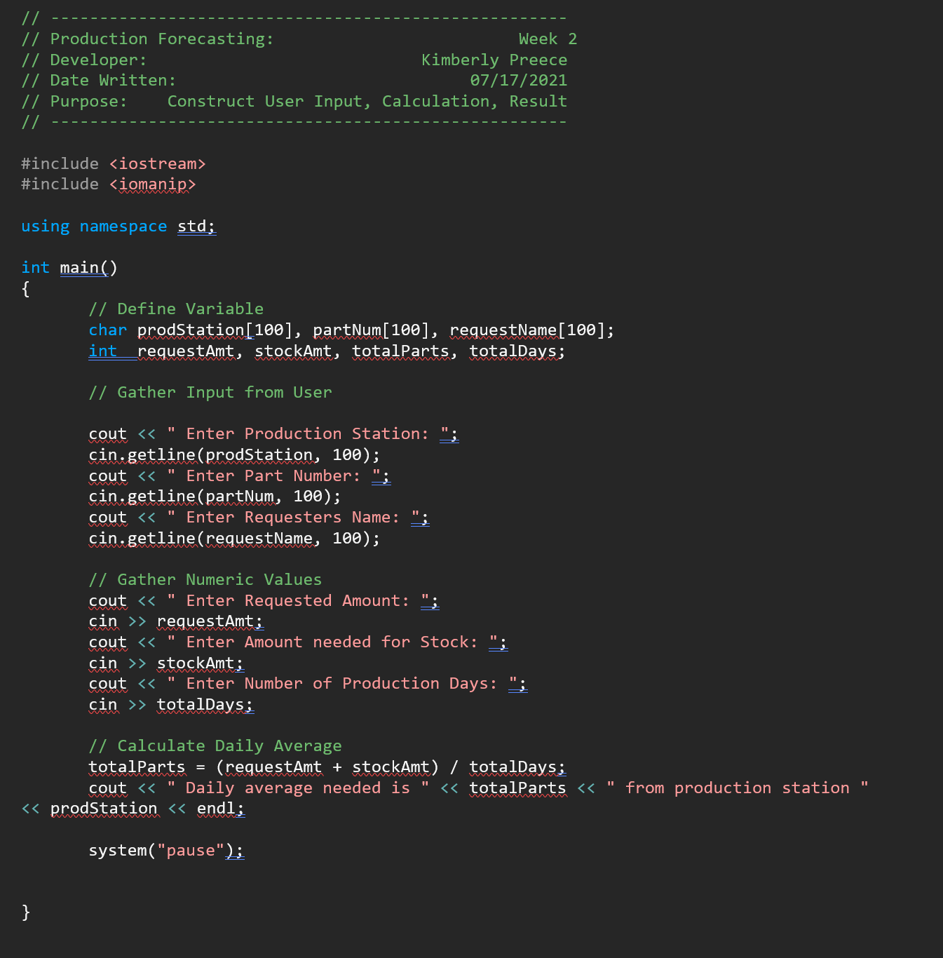
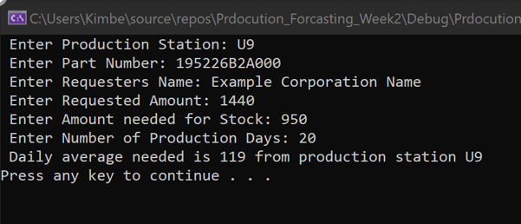

Flowchart cont.
Code:
Output:

Slide 8
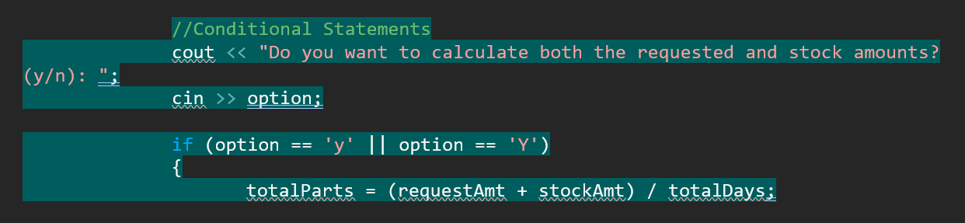
Conditional expression
Objective:
Add at least one conditional expression to your program.
I wanted to add a calculation based on user input. Here I have added a simple y/n? whether the user wanted to include both requested and stock amount together in the production forecast.
Highlights: Areas highlighted in blue represent the conditional expressions added for this portion of the project.

Slide 9
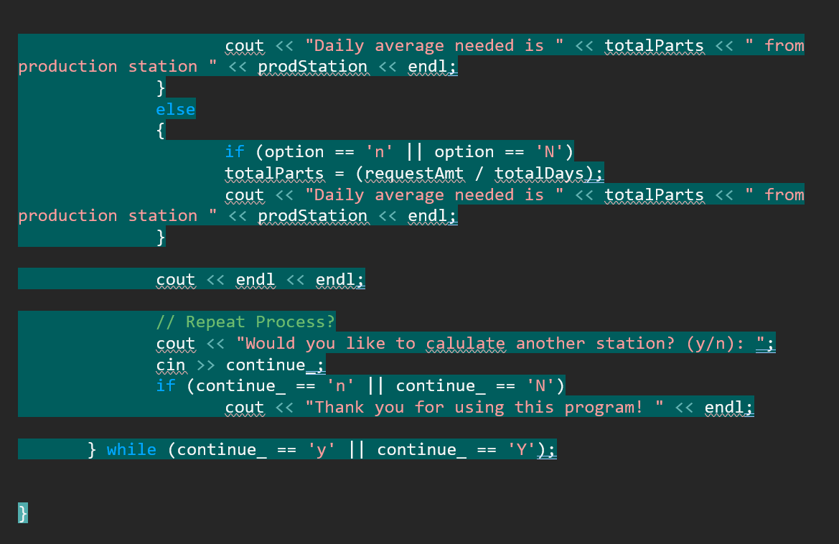
Cond. Statement cont.

Slide 10
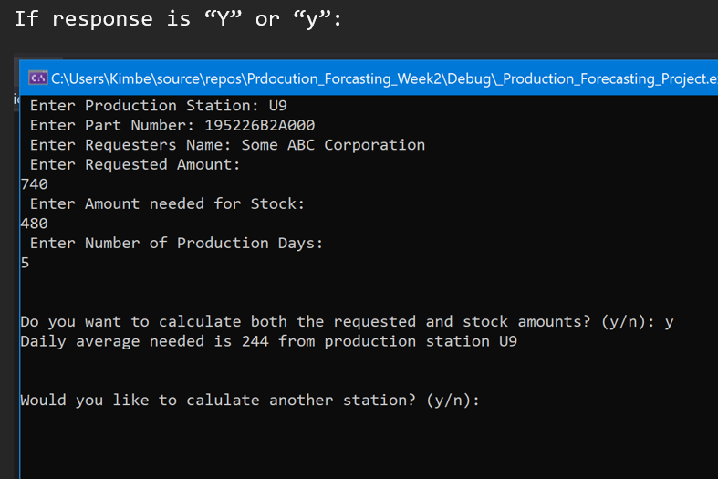
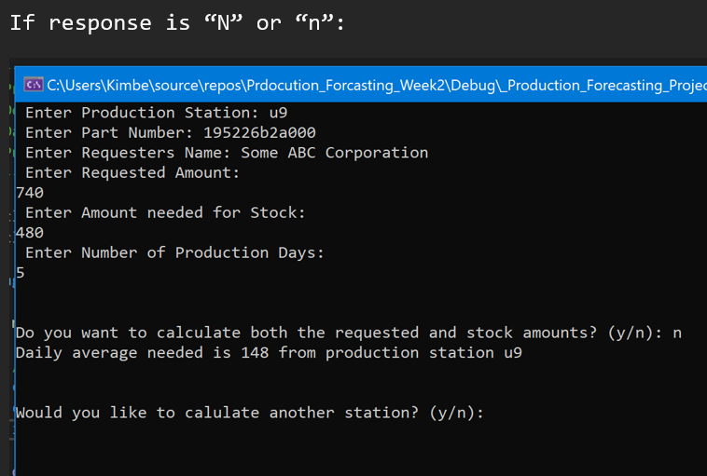
Cond. Statement cont.
Output:

Slide 11
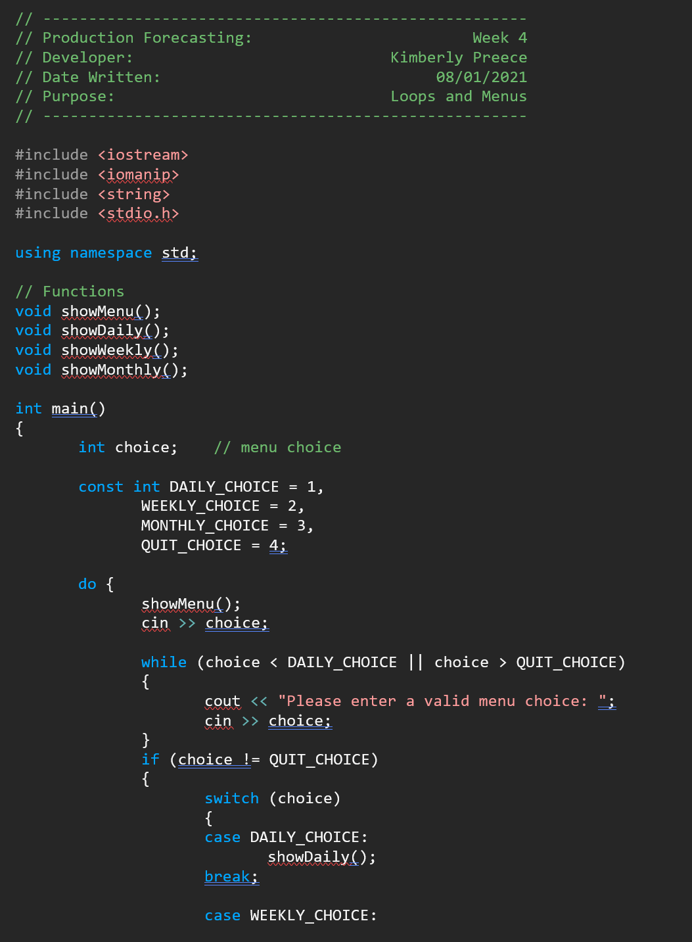
loops
Objectives:
Add loops to validate data. Add a menu to your program that allows users to use the various features or exit the program.
Code: Project was completely redone to incorporate a menu and void functions. Each void function contains loops and conditional statements.

Slide 12
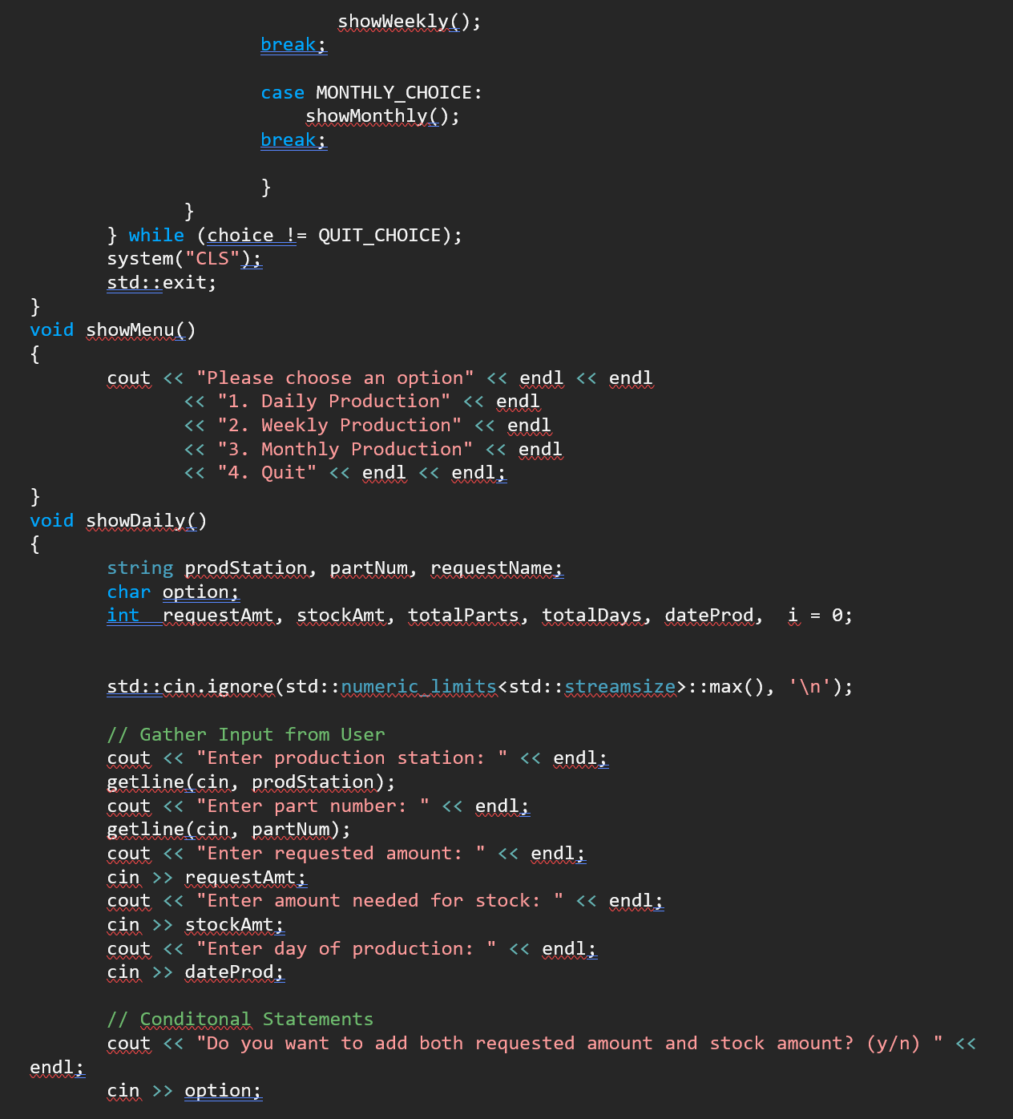
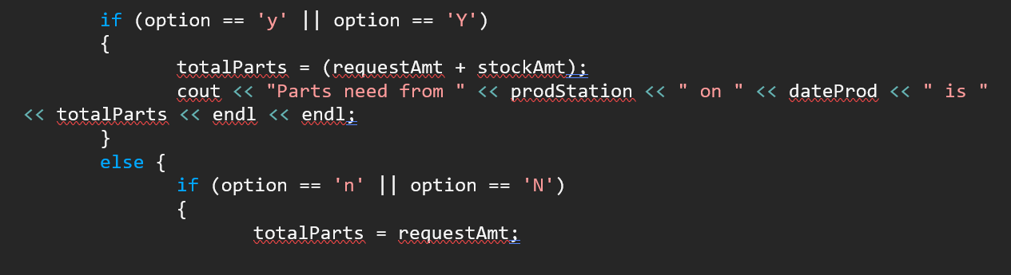
Loops cont.

Slide 13
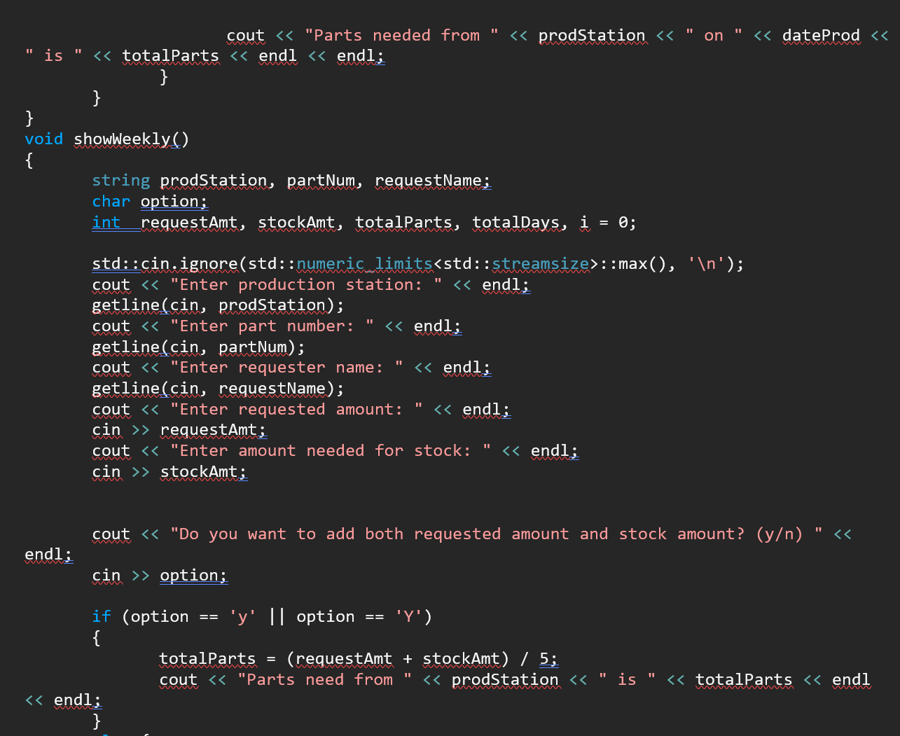
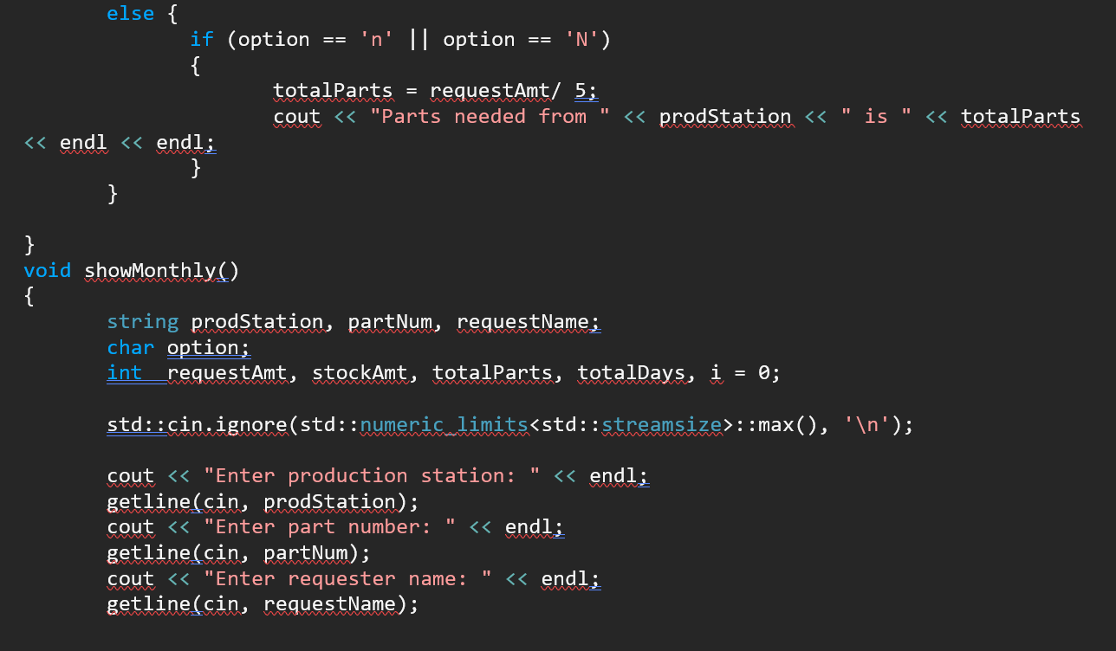
Loops cont.

Slide 14
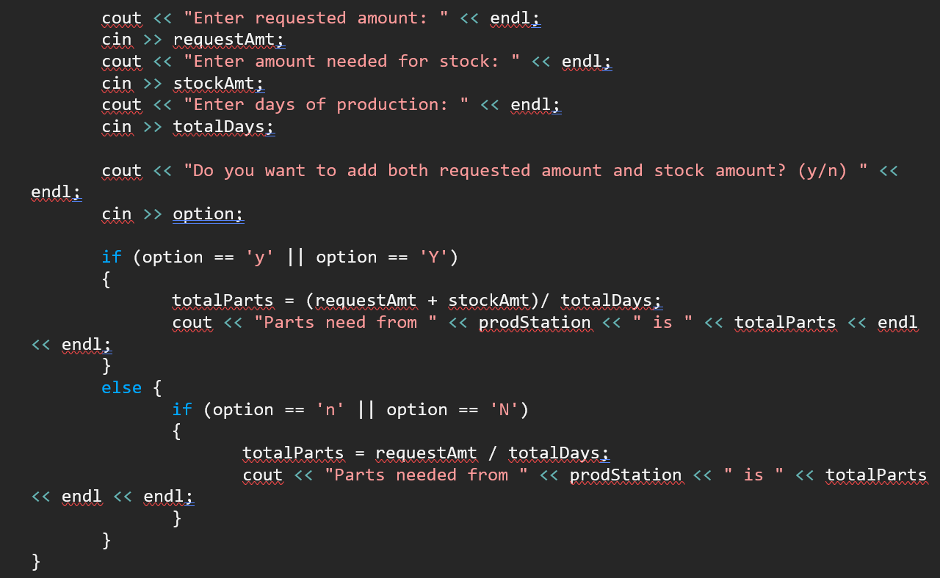
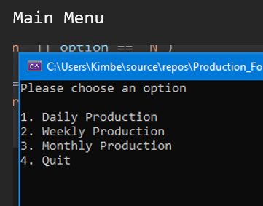
Loops cont.

Slide 15
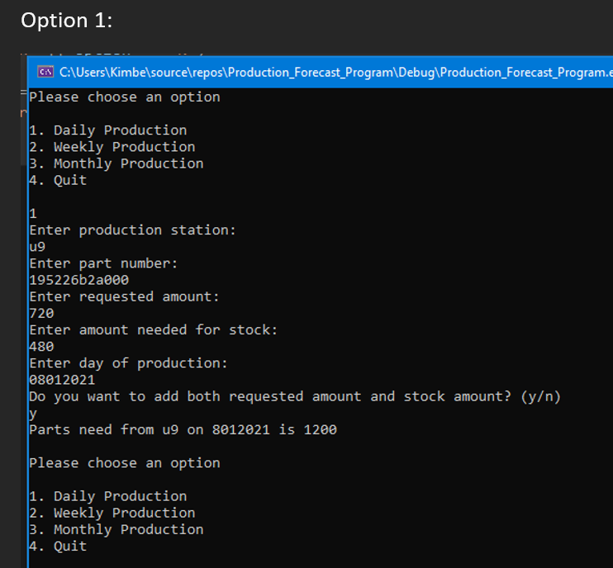
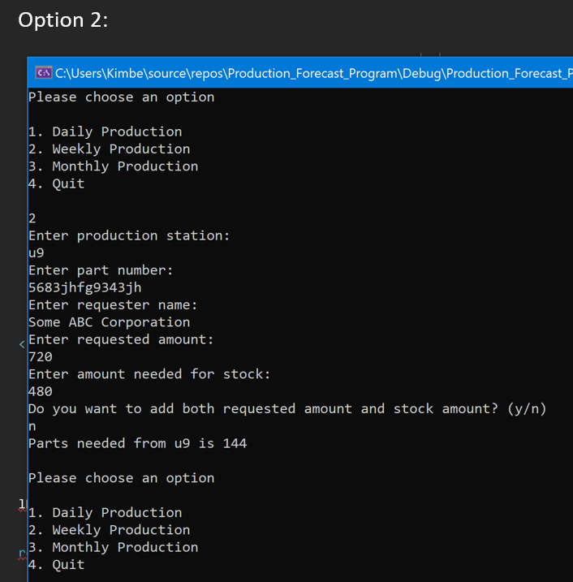
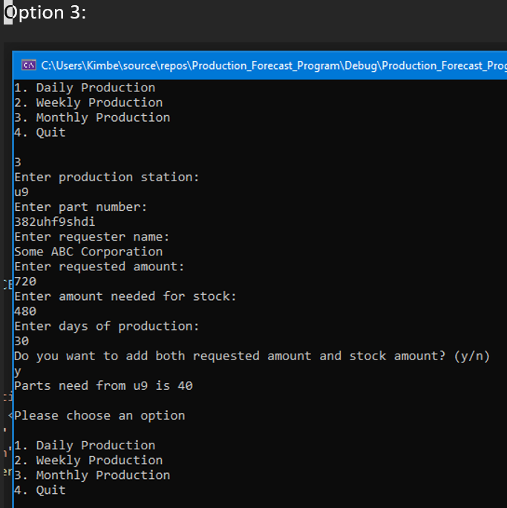
Loops cont.

Slide 16
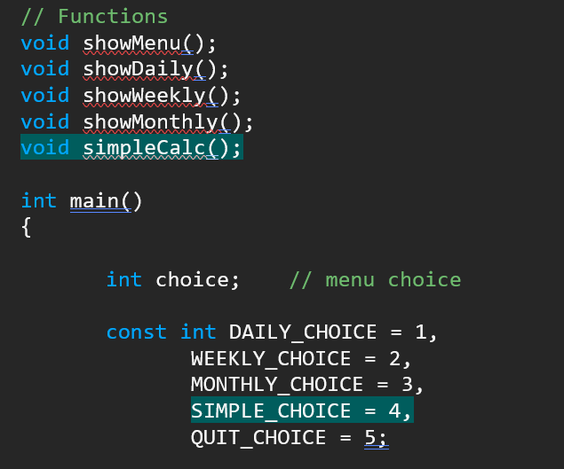
ARRAYS
Objective:
Add arrays to your program to handle more data.
Description:
Several different arrays were added for this week’s portion of the project including:
Random Order Number Generator
Simple Calculator
Station Array table- Displaying stations and total amounts needed
All Additions have been Highlighted for easy reference.

Slide 17
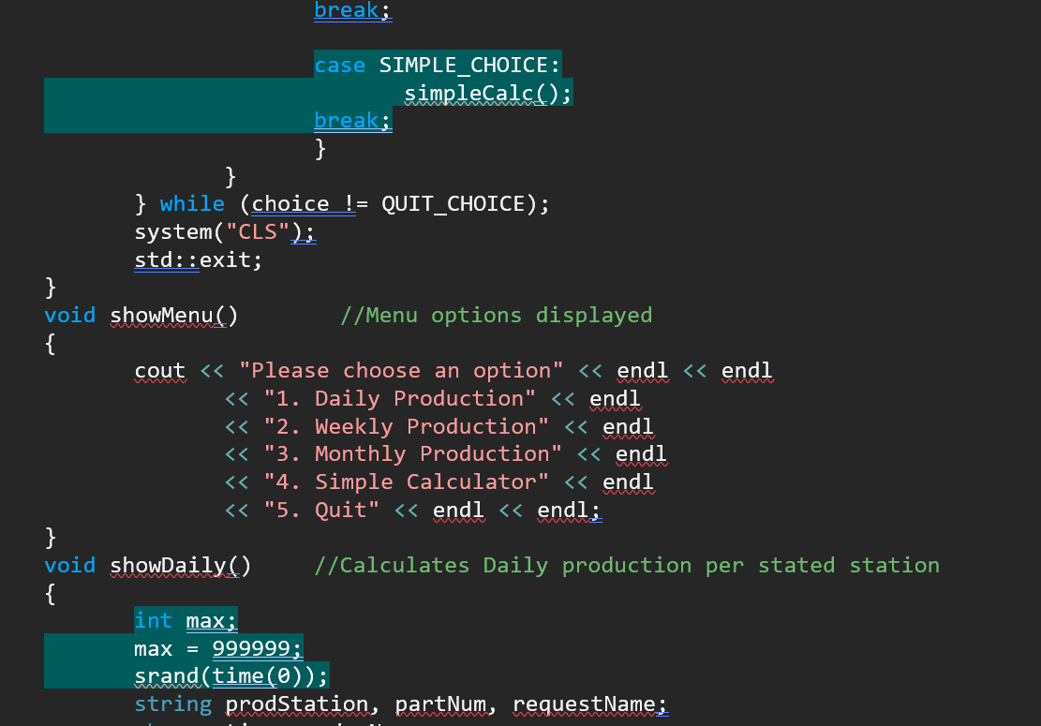
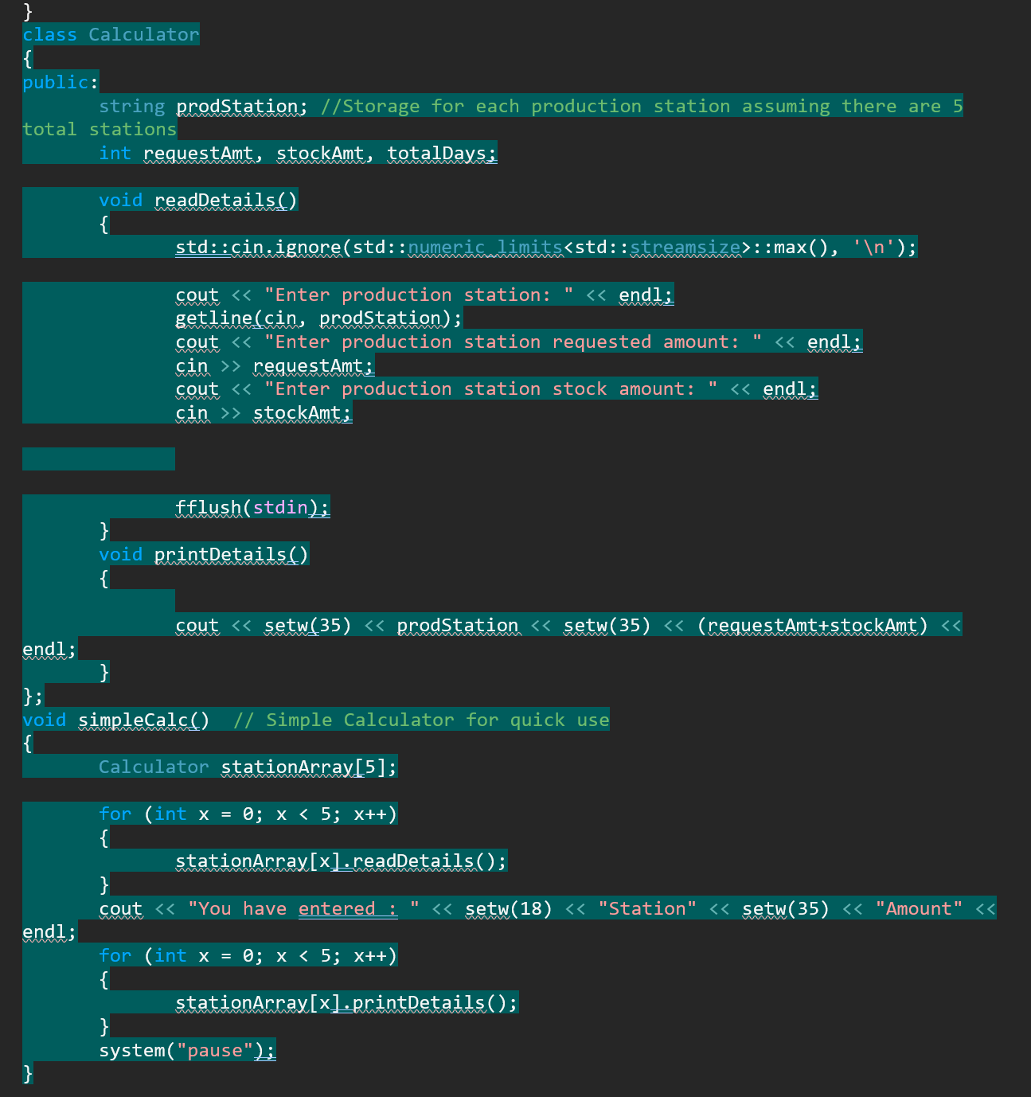
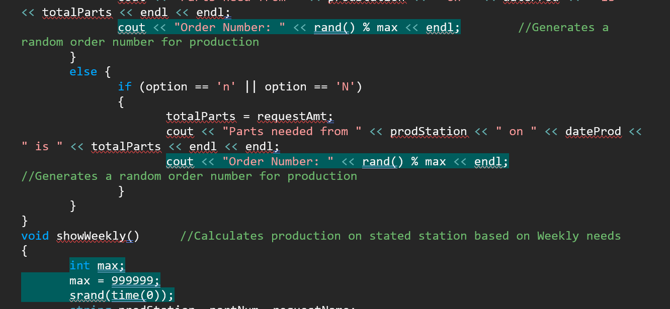
Arrays cont.

Slide 18
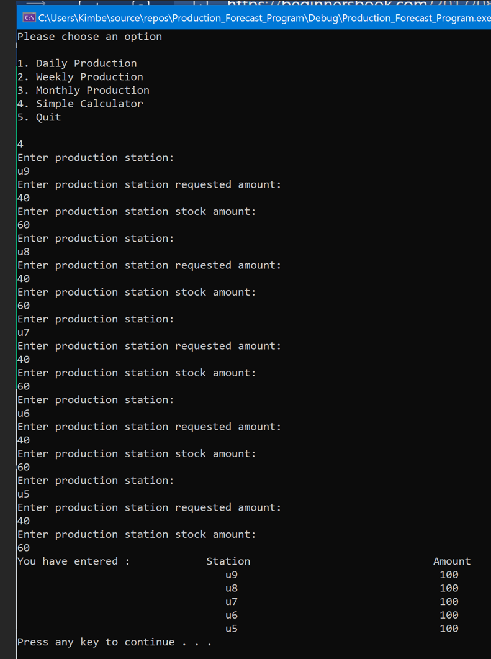
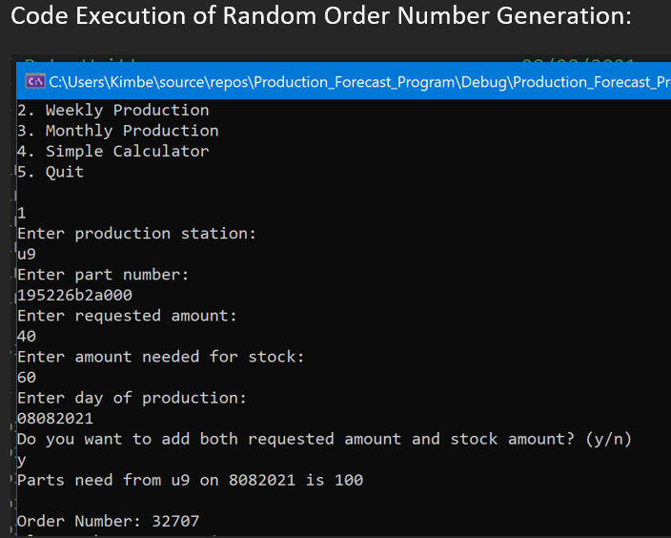
Arrays cont.

Slide 19
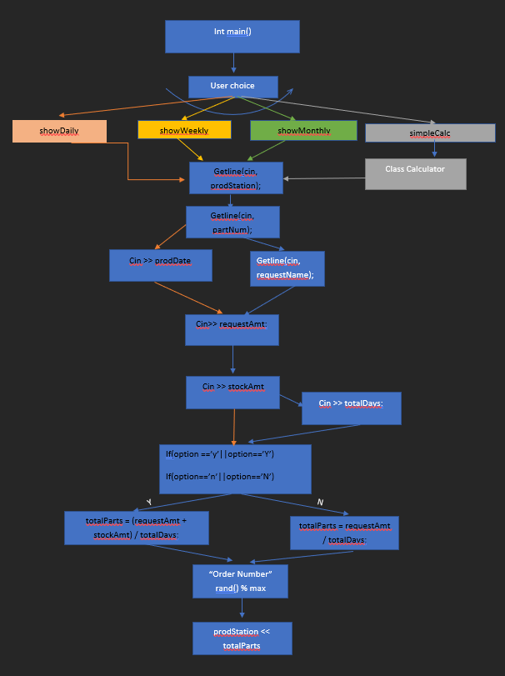
Hierarchy chart
Objective:
Create a hierarchy chart showing the logical components of your program. Modularize your code according to your chart using the practices learned this week. Your menu should now call individual modules to do the work of the program.
Problem Chosen to solve and meet this Weeks expectations:
This week I have chosen to take the section of my code that was created as a class and give it its own file. After transferring to another file “Calculator.cpp” all that was left was to make sure my “ProdForecastMain.cpp” could pull the data when needed. This took a simple include statement of #include “Calculator.cpp” at the top of my work. After running the program, it shows that the simple calculator portion still works as expected.

Slide 20
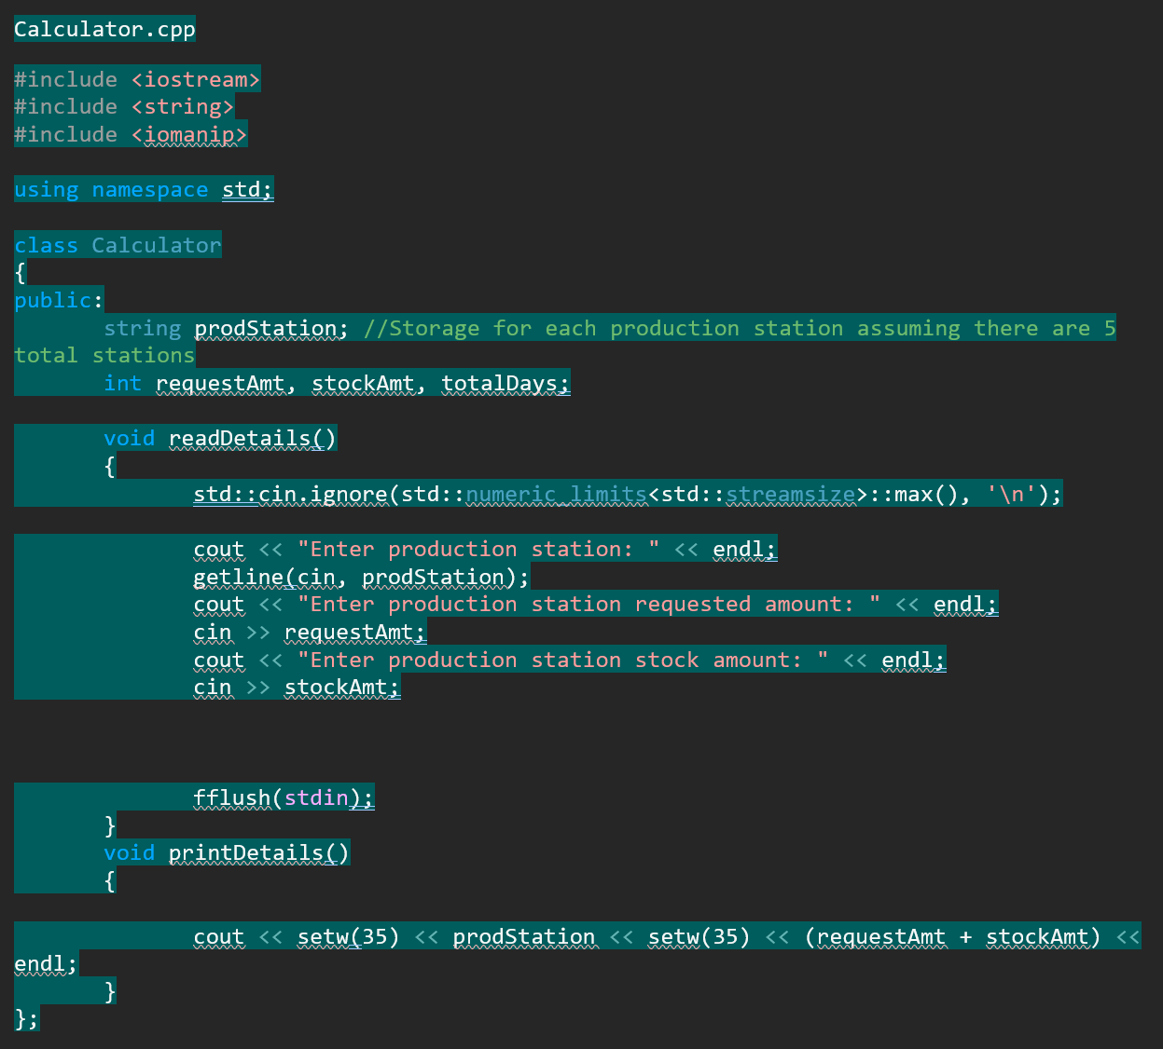
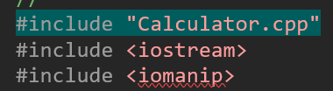
Hierarchy cont.

Slide 21
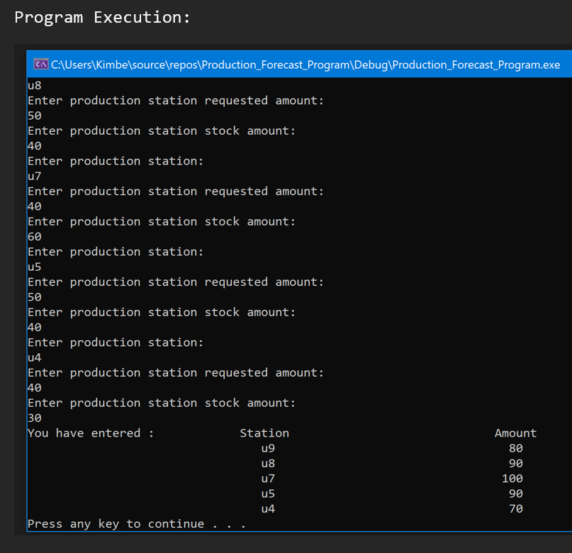
Hierarchy cont.
Output:

Slide 22
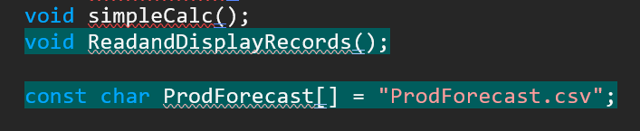
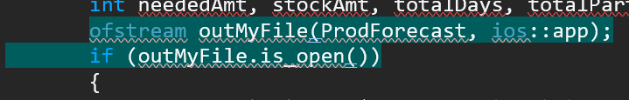
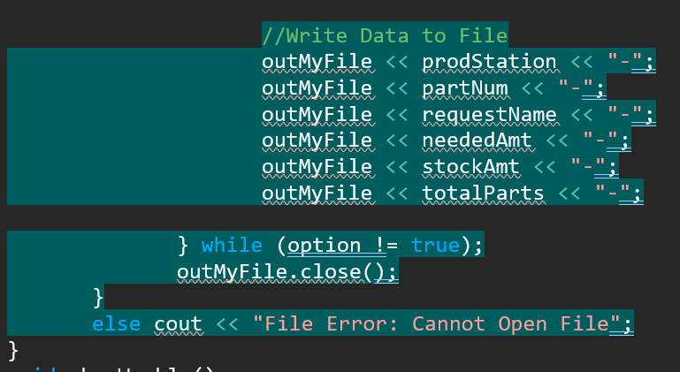
Save/retrieve data
Objective:
Add the ability to save data to disk in one or more files. The menu(s) should give the user the option to save or retrieve data.
Chosen Improvement:
This week we needed to incorporate a way for users to save and retrieve data. Within my project I have added a way for users to input the needed production and pull the records for those inputs.

Slide 23
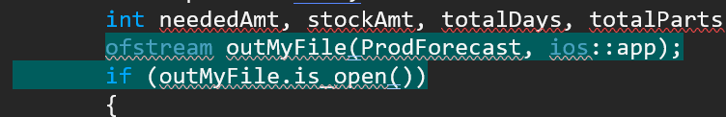
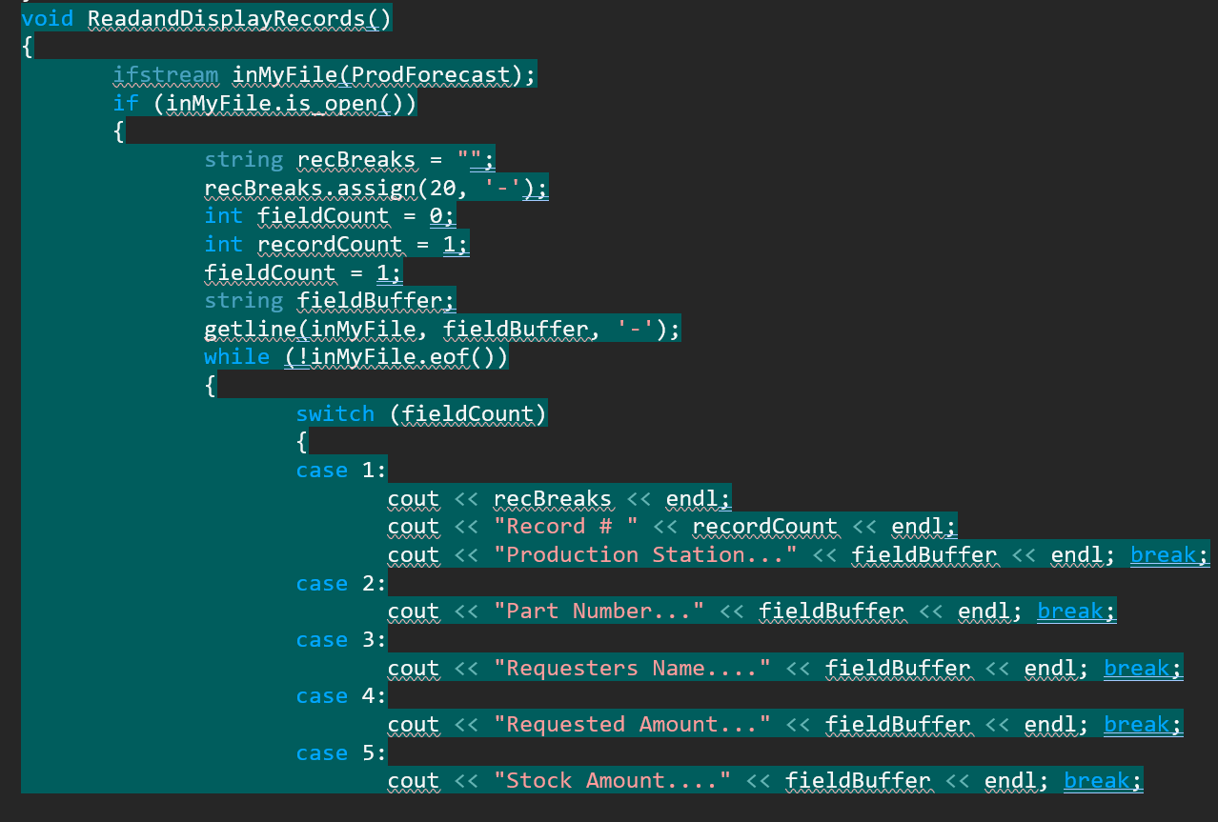
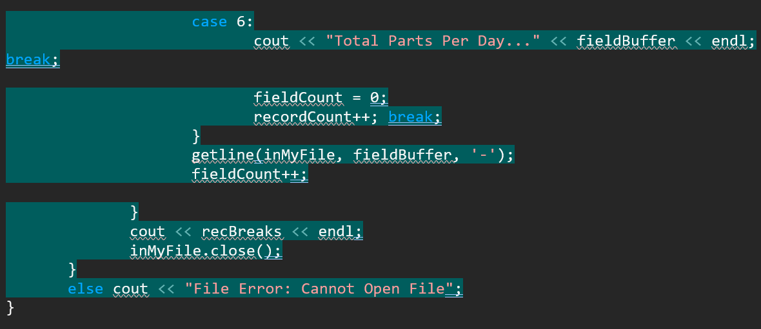
Save/retrieve cont.

Slide 24
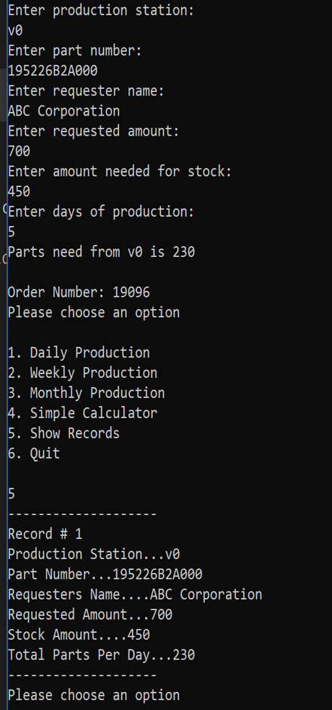
Save/retrieve data cont.
Output:

Slide 25
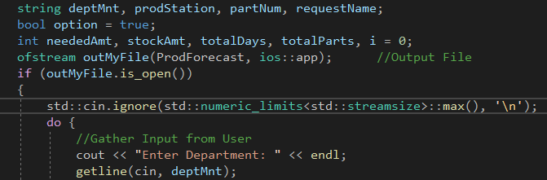
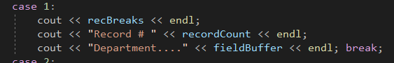
Additional Input
Add one new feature you have not added. This could be an additional array or function, an additional calculation, more inputs, or even try adding color.
I chose to add additional inputs for Department. These additions are seen here as deptMnt.

Slide 26
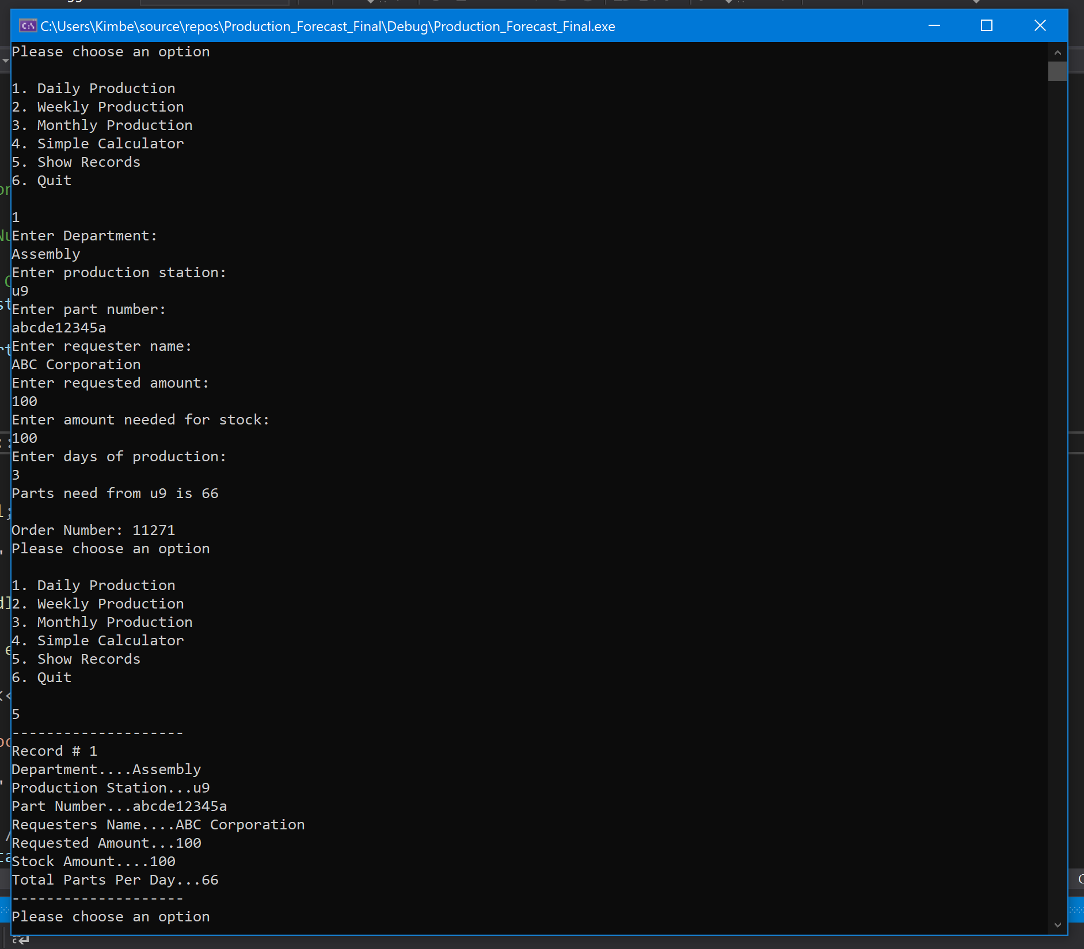
Input cont.
The code execution shows the output asking the user for Department Name and the Record display of entered name.

Slide 27
Challenges
This program proved to be slightly more challenging than anticipated. When setting up the code it became clear I would need to do a bit of outside research to get the output I was initially wanting.
Learning the proper and most up to date implantations of code was also a bit challenging as many sources outside of my college course were slightly dated.

Slide 28
Future improvements
There are many improvements I would like to make to my program including:
Valid/ Invalid entry color text
Better formatting
Data exportation to Excel Format
GUI buttons
User Input updating features
Etc.

Slide 29
conclusion
This project was very enjoyable to make and only confirmed my choice in study and career were right even more. I feel I have learned many valuable things throughout this project, and I can not wait to continue working towards the program I know it can be. I am also very excited to use the knowledge I have gained to create many new and useful things for myself and others.

